Slide 1

Project Title -Airbnb Hotel Booking Analysis
AICTE STU ID:STU698ee416d64e61770972182
Charvande Shivani Radhakisan

Slide 2

PROBLEM STATEMENT
Airbnb generates a large amount of data related to properties, hosts, prices, reviews, availability, and locations. Analysing this data can help identify the major factors that influence listing performance and Guest satisfaction.
This project analyses New York City Airbnb listings to identify:
  Popular neighbourhoods and room types
  Pricing patterns across locations
  Host performance and verification
  Review ratings and guest preferences
  Relationship between price, service fee, and availability
Goal: To generate data-driven insights that help hosts optimize listings and improve guest experience.

Slide 3
PROJECT DESCRICTION
The Airbnb Hotel Booking Analysis project uses an Airbnb Open Data dataset containing 102,599 listings and 26 attributes.
The analysis involves:
Data Collection – Importing the Airbnb dataset.
Data Wrangling – Handling missing values, inconsistent values, and data types.
Exploratory Data Analysis – Examining prices, reviews, locations, room types, and hosts.
Data Visualization – Creating charts and graphs to identify patterns.
Correlation Analysis – Studying relationships between numerical variables.
Insight Generation – Extracting useful business insights and recommendations.
Tools Used: Excel / Python / Pandas / Matplotlib / Seaborn / Power BI

Slide 4
Dataset Overview
Attribute | Details
Total Records | 102,599
Total Columns | 26
Location | New York City
Main Entities - | Listings, Hosts, Neighborhoods
Room Types | 4
Major Variables - | Price, Service Fee, Reviews, Availability
Host Variables - | Host Identity, Host Listing Count
Location Variables - | Neighborhood Group, Neighborhood, Latitude, Longitude

Slide 5
Data Wrangling
Data wrangling was performed to make the raw Airbnb data suitable for analysis.
Major Steps:
Identified missing values.
Checked duplicate and inconsistent records.
Converted numerical columns into appropriate numeric formats.
Standardized neighborhood group values.
Handled missing review and host information.
Examined outliers in price and availability.
Prepared Ahe cleaned dataset for visualization and analysis.
Examples of Data Issues Identified:
Missing listing names
Missing host identity information
Missing review information
Missing license information
Inconsistent neighborhood names such as brookln and manhatan

Slide 6

WHO ARE THE END USERS?
1. Airbnb Hosts
Can use the analysis to optimize pricing, availability, and listing strategies.
2. Airbnb Management
Can understand market trends and improve platform performance.
3. Guests/Travelers
Can compare locations, room types, prices, and ratings before booking.
4. Property Managers
Can identify profitable locations and understand competitor listings.
5. Data Analysts & Researchers
Can use Airbnb data to study hospitality and tourism trends

Slide 7
Technology Used
1.Data Processing
Microsoft Excel
Python
Pandas
NumPy
2.Data Visualization
Matplotlib
Seaborn
Power BI / Tableau
3.Analysis
Exploratory Data Analysis (EDA)
Statistical Analysis
Correlation Analysis
4.Presentation
Microsoft PowerPoint

Slide 8
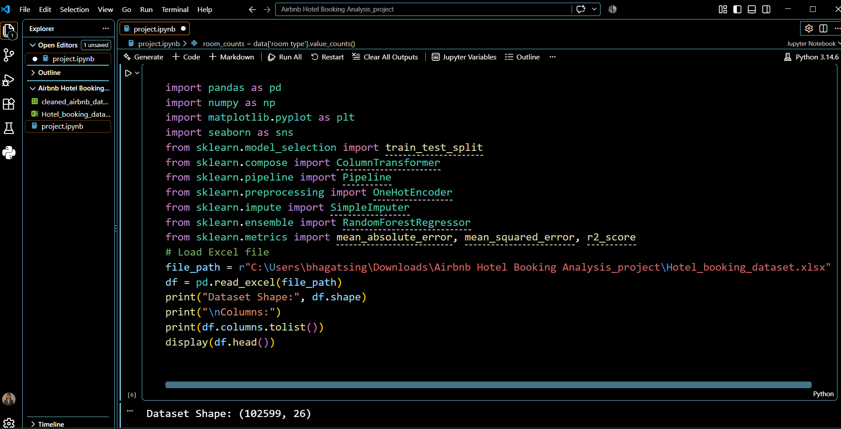
RESULTS
"C:\Users\bhagatsing\Videos\dscx.mp4"
Demo Link :https://charvandeshivani.github.io/Airbnb-Hotel-Booking-Analysis_project/

Slide 9
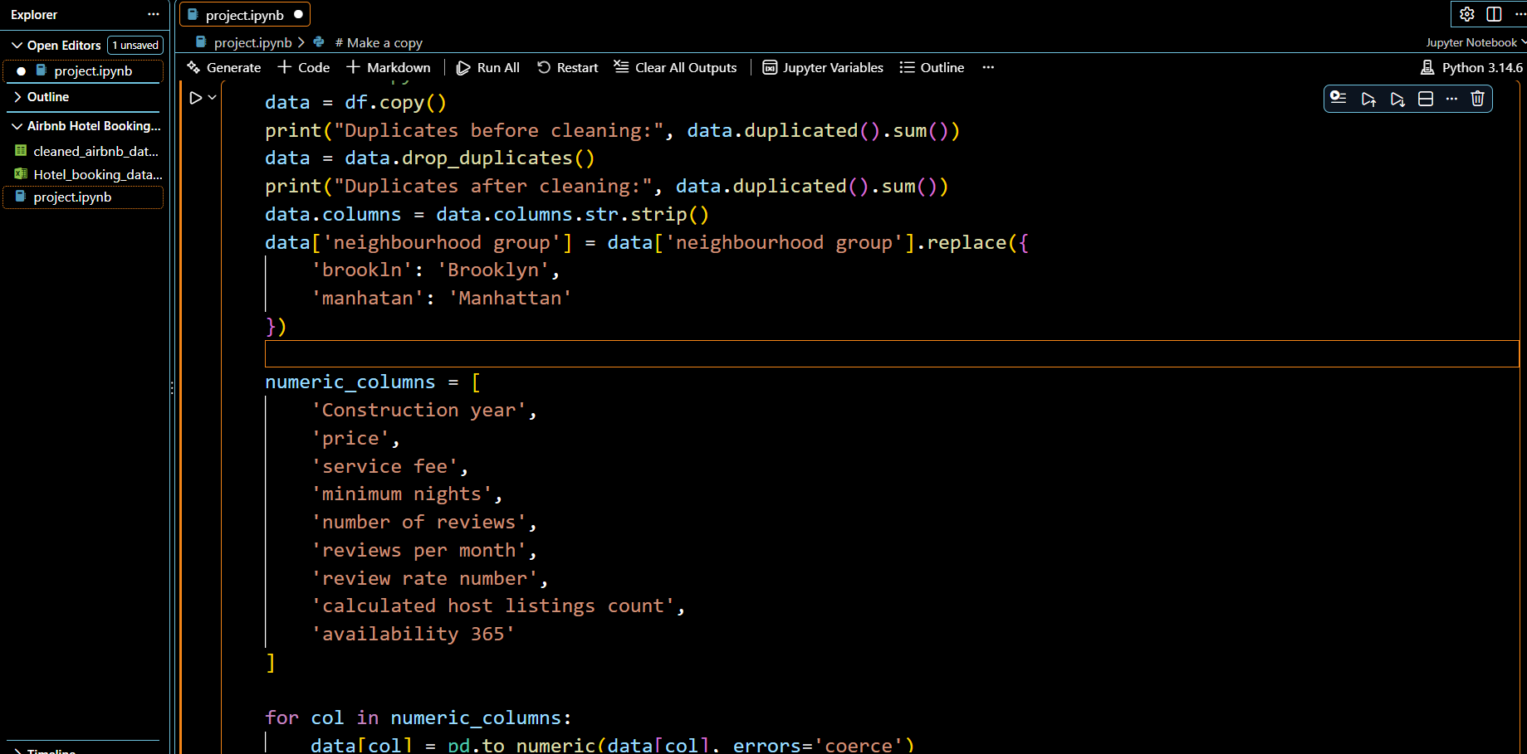

Slide 10
Thank you
.
.

